Slide 1

Lecture 5
Tables
Notes:
Welcome to this M1 in SQL Course. In this first chapter of the course, we are going to do an introduction of databases and relational databases.

Slide 2

A G E N D A
Tables
Table Headers
Column Width / Row Height
Colspan / Rowspan

Slide 3
Tables
Notes:
Without further adieu, Let’s look at the course introduction so that you will know what you are going to learn.

Slide 4

Tables
HTML tables allow web developers to arrange data into rows and columns.
<table>
<tr>
<td>Drinks</td>
<td>Price</td>
</tr>
<tr>
<td>Coffee</td>
<td>$2</td>
</tr>
<tr>
<td>Tea</td>
<td>$1</td>
</tr>
</table>
Drinks | Price
Coffee | $2
Tea | $1
Reference
Tags | Explanation
<table> | Defines a table
<tr> | Defines a row in a table
<td> | Defines a cell in a table

Slide 5
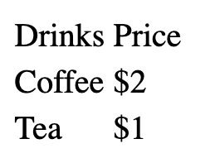

Tables
<table>
<tr>
<td>Drinks</td>
<td>Price</td>
</tr>
<tr>
<td>Coffee</td>
<td>$2</td>
</tr>
<tr>
<td>Tea</td>
<td>$1</td>
</tr>
</table>
The output above seems like a mere text.
How are tables different from normal text?

Slide 6
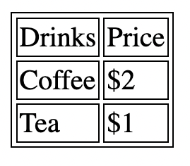
Tables
In order to visualize our tables better, we would be adding some borders to our table for better understanding. Explanations of how borders work will be given later in the CSS chapters.
<table>
<tr>
<td>Drinks</td>
<td>Price</td>
</tr>
<tr>
<td>Coffee</td>
<td>$2</td>
</tr>
<tr>
<td>Tea</td>
<td>$1</td>
</tr>
</table>
(A table with 3 rows and 2 columns)

Slide 7
Table Headers
Notes:
Without further adieu, Let’s look at the course introduction so that you will know what you are going to learn.

Slide 8

Table Headers
Sometimes we want an entire row to act as headers for the respective columns
<th> defines a header cell in a table
Table Headers
<table>
<tr>
<th>Drink 1</th>
<th>Drink 2</th>
<th>Drink 3</th>
</tr>
<tr>
<td>Coffee</td>
<td>Tea</td>
<td>Milk</td>
</tr>
</table>

Slide 9
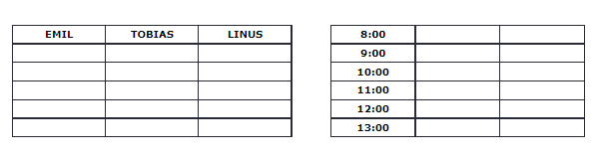
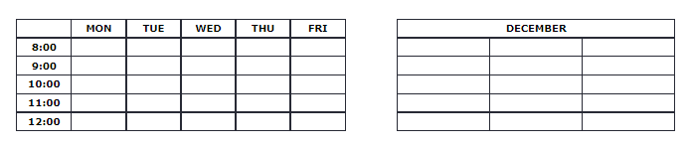
Table Headers
Till now, we have only seen Headers appear at each column of the top row of the table (top horizontal)

Slide 10
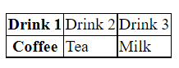
Table Headers
Explanation:
To understand this simply, pick the first cell in each row and convert it into <th>. You will then have a vertical header.
Vertical Headers
<table>
<tr>
<th>Drink 1</th>
<td>Drink 2</td>
<td>Drink 3</td>
</tr>
<tr>
<th>Coffee</th>
<td>Tea</td>
<td>Milk</td>
</tr>
</table>

Slide 11
Column Width / Row Height
Notes:
Without further adieu, Let’s look at the course introduction so that you will know what you are going to learn.

Slide 12

Table Dimensions
Similar to Image Dimensions, we would be learning some specific styling that is applied to tables. These can help us to manipulate column width and row height.
In order to increase a column width, we specify the style in <th> or <td>
In order to increase row height, we specify the style in <tr>.
Let us see in-depth examples of both of these cases

Slide 13
Table Dimensions
Let us use this example to play around.
<table>
<tr>
<th>Drink 1</th>
<th>Drink 2</th>
<th>Drink 3</th>
</tr>
<tr>
<td>Coffee</td>
<td>Tea</td>
<td>Milk</td>
</tr>
</table>

Slide 14

Table Dimensions
Explanation:
Usually, columns are divided in width equally (33%). However, now column 1 takes up 70% of the space, with the rest 30% being distributed equally between Column 2 and Column 3
Column Width
<table>
<tr>
<th style="width:70%">Drink 1</th>
<th>Drink 2</th>
<th>Drink 3</th>
</tr>
<tr>
<td>Coffee</td>
<td>Tea</td>
<td>Milk</td>
</tr>
</table>

Slide 15
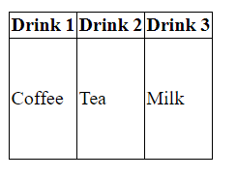
Table Dimensions
Explanation:
Usually, rows are divided in height equally. However, now row 2 takes up 100px of the space, whereas row 1 only takes up as much space as it needs.
Row Height
<table>
<tr>
<th>Drink 1</th>
<th>Drink 2</th>
<th>Drink 3</th>
</tr>
<tr style="height:100px">
<td>Coffee</td>
<td>Tea</td>
<td>Milk</td>
</tr>
</table>

Slide 16
Colspan / Rowspan
Notes:
Without further adieu, Let’s look at the course introduction so that you will know what you are going to learn.

Slide 17
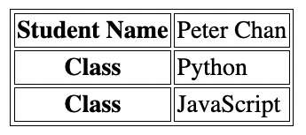
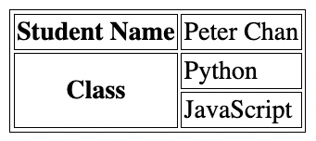
Table Colspan/ Rowspan
Example:
In this example, we can observe that there are 3 rows. However, the Phone header spans multiple rows. This is necessary because Jill has two phone numbers.

Slide 18

Table Colspan/ Rowspan
Explanation:
colspan=”2” instructs the table to stretch the cell to fill two columns.
Colspan
<table>
<tr>
<th colspan="2">Name</th>
<th>Gender</td>
</tr>
<tr>
<td>Peter</td>
<td>Chan</td>
<td>M</td>
</tr>
</table>

Slide 19
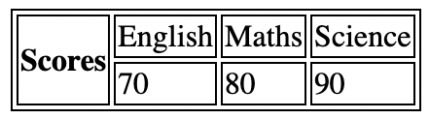
Table Colspan/ Rowspan
Explanation:
rowspan=”2” instructs the table to stretch the cell to fill two columns.
Rowspan
<table>
<tr>
<th rowspan="2">Scores</th>
<td>English</td>
<td>Maths</td>
<td>Science</td>
</tr>
<tr>
<td>70</td>
<td>80</td>
<td>90</td>
</tr>
</table>

Slide 20

That’s all for this module!
THANK YOU!

